Slide 1
COMP3000 PROJECT
VARIANCE

Slide 2

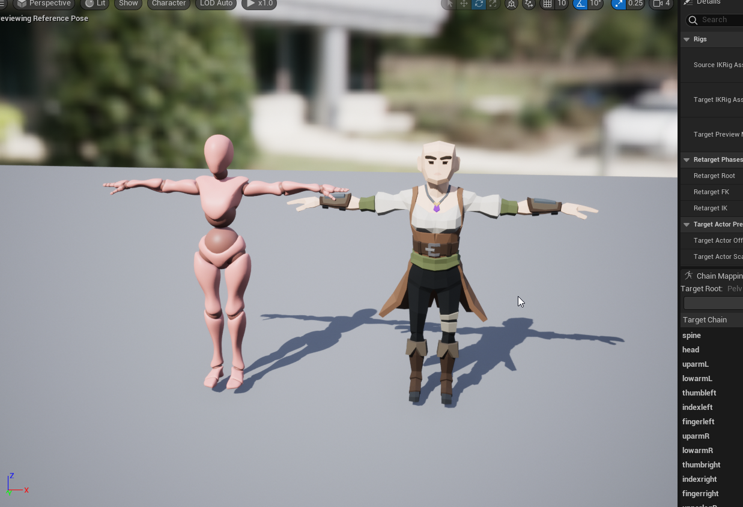
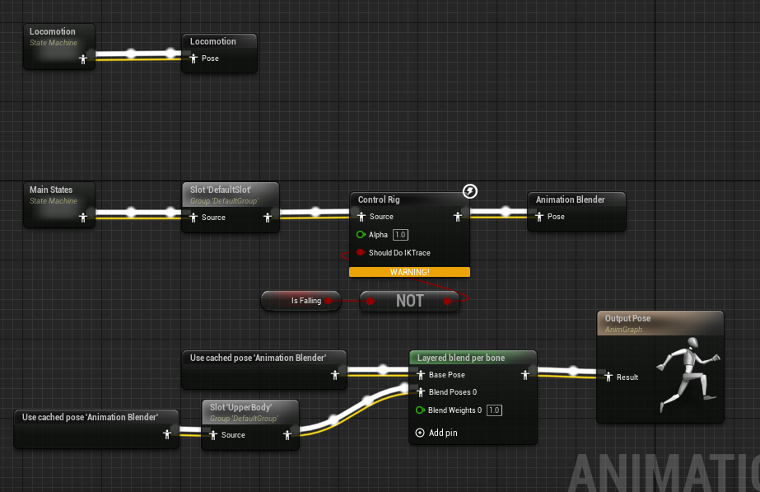
SPRINT 2 RESULTS
Mixamo animation retargeter constructed
Basic player punch interaction
Animation blending setup

Slide 3
Sprint 2 reflection
Animation in Unreal is really hard…
Missed goal for basic enemy controller, level design planning
Punch animation speed is broken by player movement

Slide 4
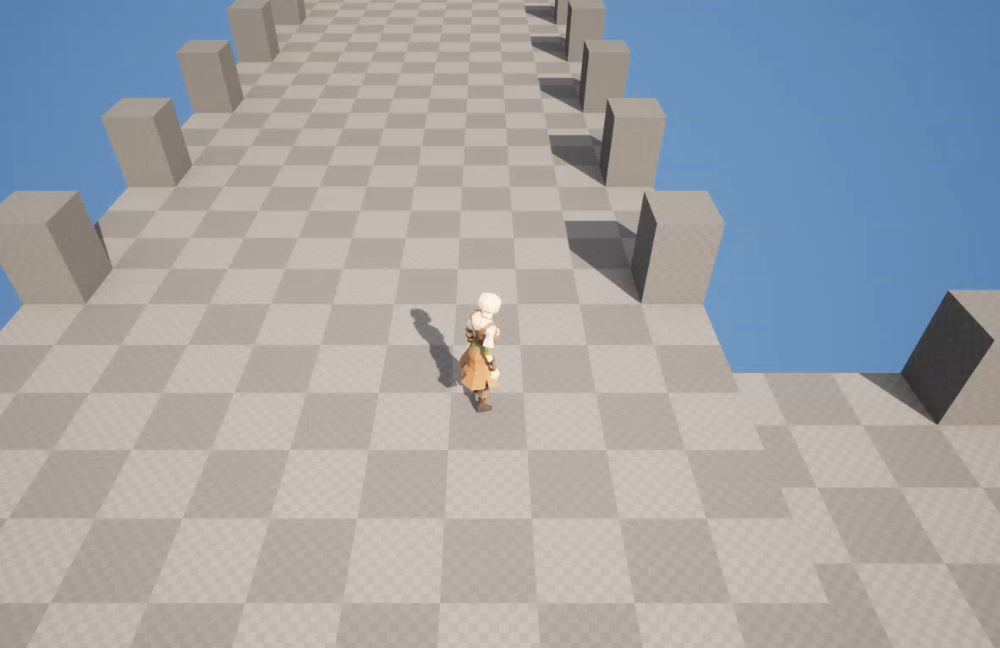

Slide 5
Sprint 3 goals
Basic enemy player (something that will just spawn, and take damage)
Level design concepts, rooms, etc
Basic dungeon generation ?
Simple HUD displaying HP

